Slide 1
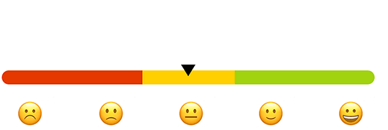
Sentiment Analysis of Drug Reviews
Kefan Li, Anjelica Ramsey, Sanjaye Thomas, Eline Van Eldere, Kenny Wu
Notes:
Eline

Slide 2
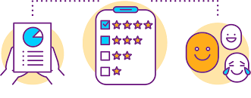
Project Abstract
Our mission was to analyze a publicly available Kaggle dataset “UCI ML Drug Review Dataset”. The dataset consists of a testing and a training file that add up to 160,000 rows and 7 columns. The drug review data contains several different brands of drugs used to treat many disorders. For our project we will use sentiment analysis to attempt to predict the rating an individual will give a drug based on their reviews. We will create an algorithm that converts qualitative consumer ratings into a quantitative metric that can be used to provide feedback to pharmaceutical companies.
Notes:
In this project, we will analyze and create visualizations that compare the air pollution in India’s four major cities pre and post COVID-19 times.
Eline

Slide 3
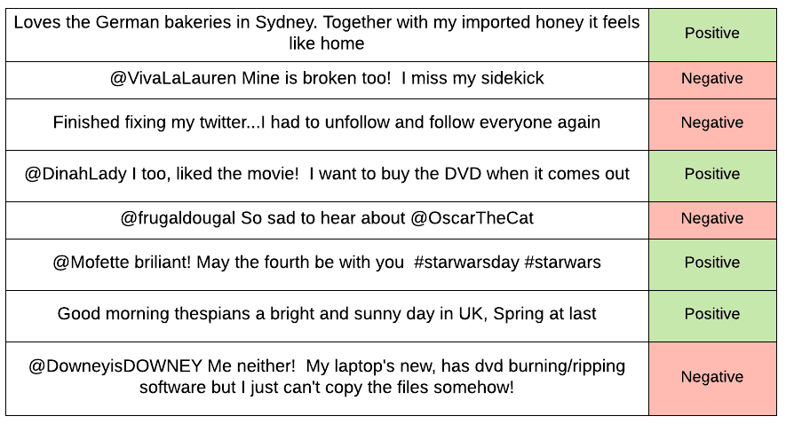
Sentiment Analysis
A text classification tool that tells whether the underlying sentiment is positive, negative, or neutral.
Notes:
Keke

Slide 4

Our methods
Agreed on a topic that we all had genuine interest in
Sought a straightforward dataset that catered to our project needs
Outlined a simple project plan with room for change
Utilized each team member’s strengths
Notes:
we cleaned the datasets together for the test and train csv, we got rid of all the html caused errors for condition columns where shows /span/ and random digits and used pandas to do the further cleaning for reviews where contains symbols, marks and emoji etcs.

Slide 5
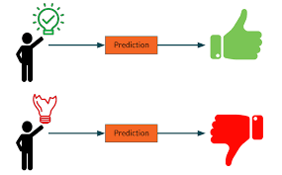
Classifying Ratings
This is usually referred to as fine-grained sentiment analysis, and could be used for ratings in a review, for example:
Positive = 6-10 → 1
Negative = 1-5 → 0
This is to improve accuracy.
Notes:
We initially started off cleaning the dataset in the csv by searching each different html error codes and symbols to replace with their actual signs or emoji for like 6 hrs straight then realized all of them should be taken out of the dataset for the latter analysis.
we cleaned the datasets all together for the test and train csv, we got rid of all the html caused errors for condition columns where shows /span/ and random digits and used pandas to do the further cleaning for reviews where contains symbols, marks and emoji etcs. In order to improve the accuracy on sentiment analysis for the review ratings, we also did swap ratings from 1 to 5 with 0 and 6 to 10 with 1.

Slide 6
Model Comparisons
Model One - Logistic Regression
Used because the outcome can have two possible types of values. For our purposes the two values are 0 and 1.
Besides accuracy, other rates in a confusion matrix can be used to describe the performance by comparing predicted and actual values giving you TP, TN, FN, FP values.
Accuracy score: 91%
Model Two - Naive Bayes
Performs well in the case of text analytics problems.
If the assumption of independence holds, a Naive Bayes classifier performs better when compared to logistic regression.
Converges quicker when compared to logistic regression.
Accuracy score:
83%
Model Three - Random Forest
Performs best with non-linear data.
Due to the type of data, the accuracy score was lower than that of logistic regression and Naive Bayes
Accuracy score: 72%
Notes:
Kenny

Slide 7
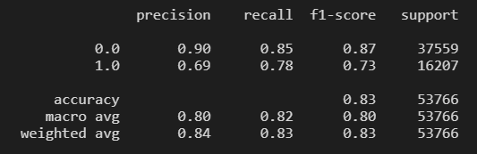
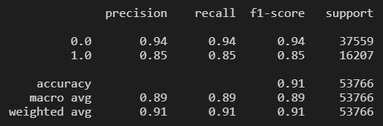
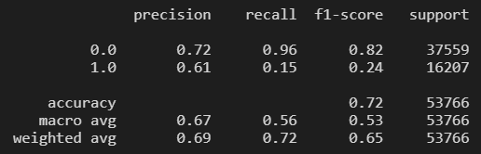



Model Comparisons - Confusion Matrix
Naive Bayes
Logistic Regression
Random Forest
Notes:
Kenny

Slide 8

Hurdles
Finding data
Picking an accurate model
PySpark
Flask
Styling Visuals with html

Slide 9

Analysis & Final Thoughts
Understanding people’s emotions is essential for businesses since customers express their thoughts and feelings more openly than ever before.
Brands to listen attentively to their customers and tailor their services to market demand.
Making sense of unstructured data.
Adding a stemmer or lemmanizer to the pipeline.
Removing neutral reviews. Then re-run the sentiment analysis on the polar sentences. This will give a more accurate sentiment score.
Notes:
Anjelica

Slide 10
Demo Time!

